Slide 1
Training multiclass process
load fadata sequence
sequence alignmean
sequence transformer to image
input gpu-tsne function
get tsne filter mat
transfer sequence to image
input alexnet model
classification
sample 1404
X
deepinsight
random seed not achieve
save location data
save image to npy
dataloader npy to image
end

Slide 2
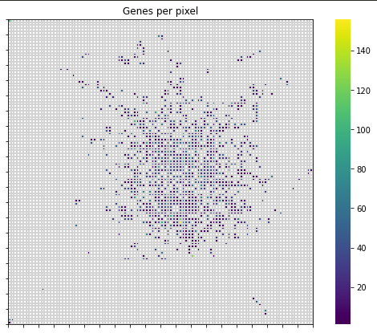
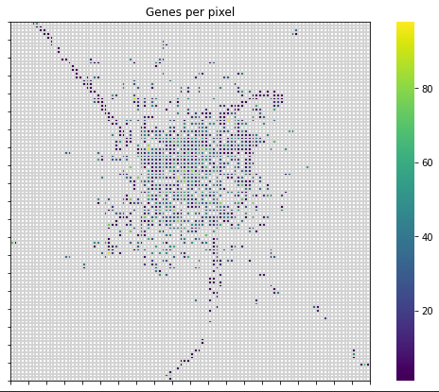
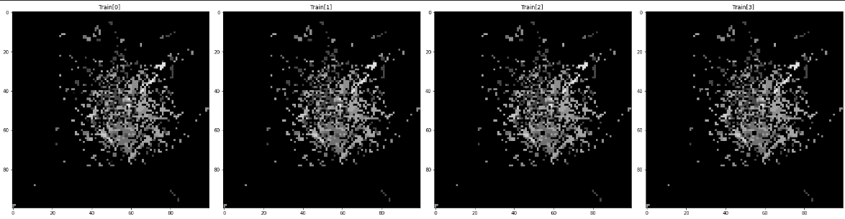
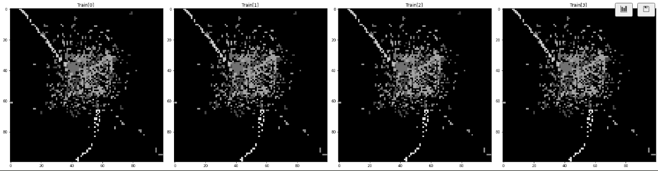

Slide 3
DeepInsight - Seq to image classification
DeepFeature - Feature Selection
Gene-Convert - Gene translate

Slide 4
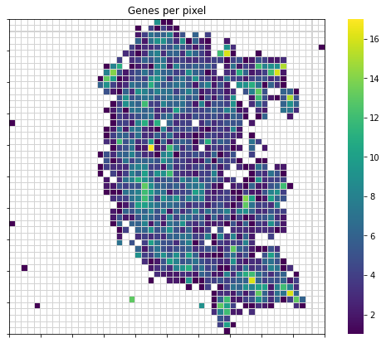
DeepInsight - TSNE matrix

Slide 5
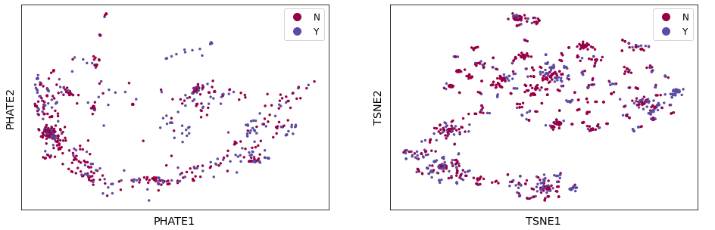
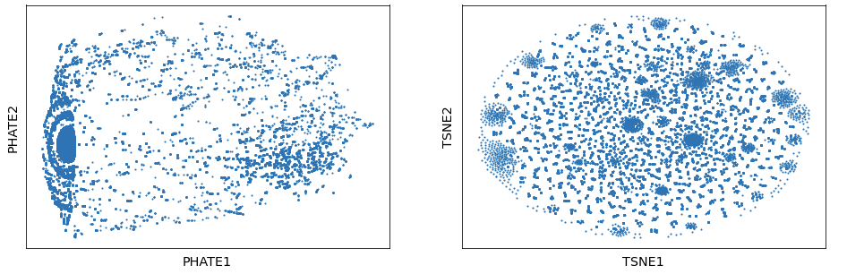
TSNE data cluster and data transpose
Sequence cluster
Sequence Transpose

Slide 6
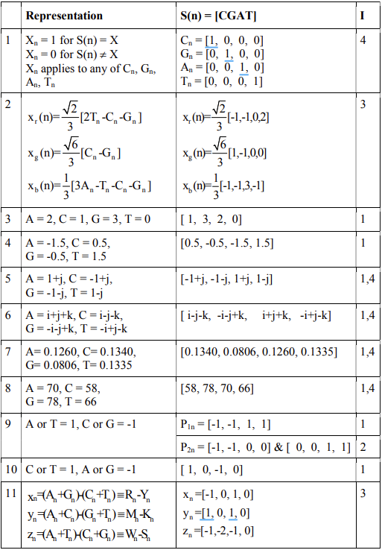
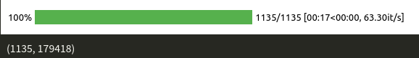

Slide 7
MultiClass - 03.22
Class : Alpha, VUM(Unclear), Beta, Delta, Eta, Gamma, Iota, Lambda, Mu, None
MLP | 2 x fc layer[1 layer = linear + BN + Dropout] + 1 x fc classification layer
LSTM | 1 x lstm layer + 1 x fc classification layer
Model |  | Train Accuracy | Test Accuracy
DeepInSight(Non-k-mer3)+AlexNet [NACGTRYKMSWBDHV] |  | ≒92.97% | ≒93.73%
DeepInSight(k-mer3)+AlexNet [NACGTRYKMSWBDHV] |  | 84.33% | 84.33%
DeepInSight(Non-k-mer3)+AlexNet [NATCG] |  | ≒95.63% | ≒96.01%
DeepInSight(k-mer3)+AlexNet [NATCG] |  | 84.33% | 84.33%
LSTM(Non-k-mer3) |  | 84.33% | ≒84.33%
MLP(Non-k-mer3) |  | ≒98.58% | ≒95.73%
LSTM(Non-k-mer3 + Onehot) |  | 84.33% | 84.33%
MLP(Non-k-mer3 + Onehot) |  | ≒99.15% | ≒97.25%

Slide 8
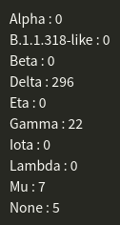
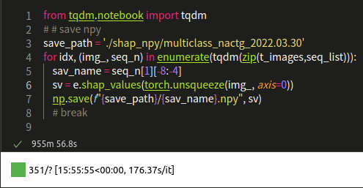
imbalance

Slide 9
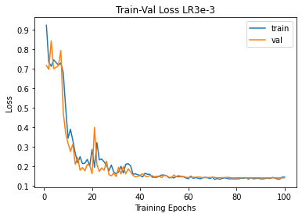
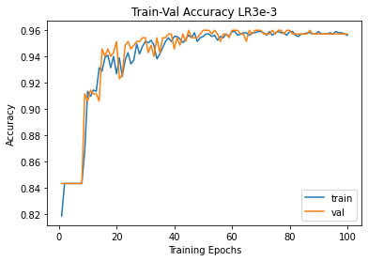
DeepInSight(Non-k-mer3)+AlexNet [NATCG]

Slide 10
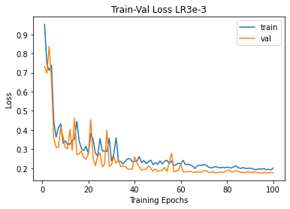
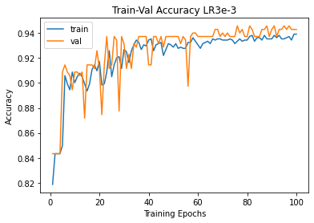
DeepInSight(Non-k-mer3)+AlexNet[NACGTRYKMSWBDHV]

Slide 11
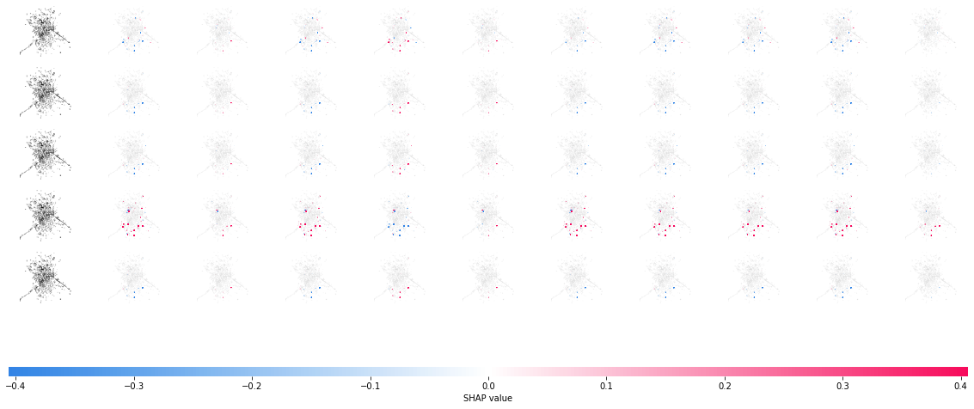
DeepExplainer - shap

Slide 12
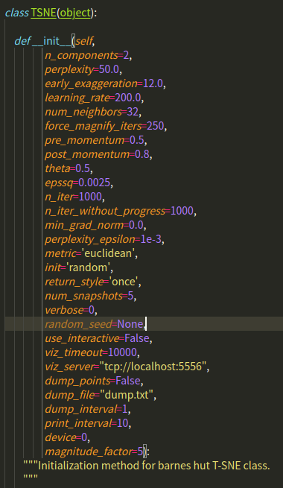
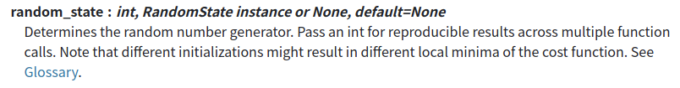
GPU-TSNE - Freeze random init not achieve

Slide 13
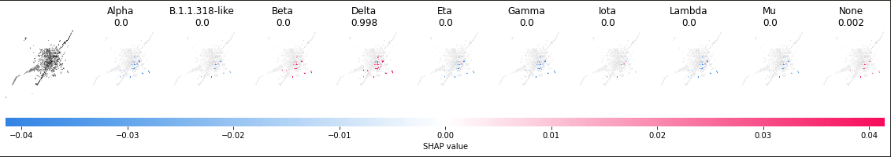
Delta Sample

Slide 14
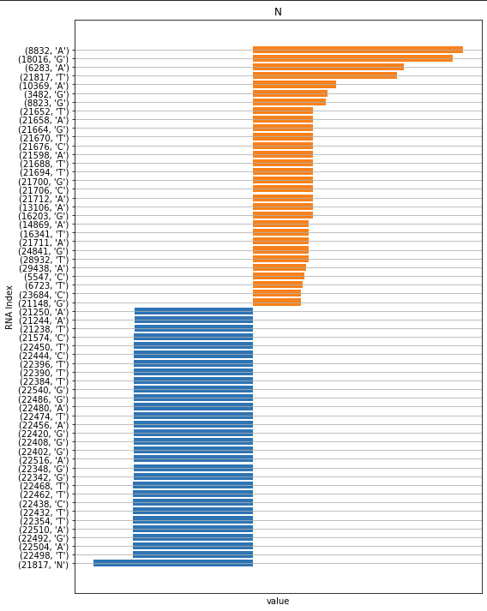
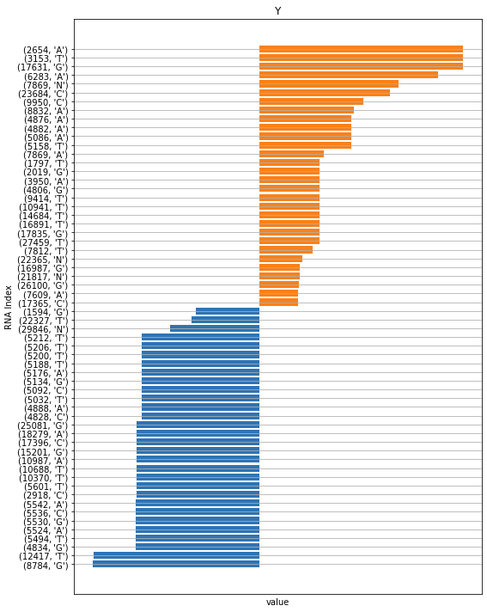
Test sample 134

Slide 15
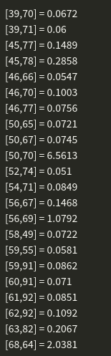
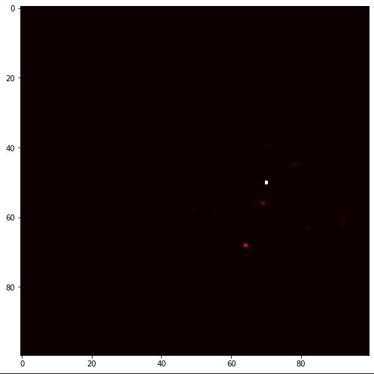
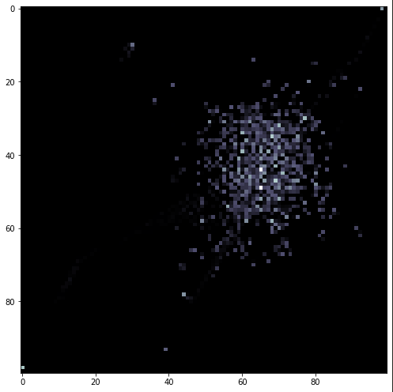
Delta Sample

Slide 16
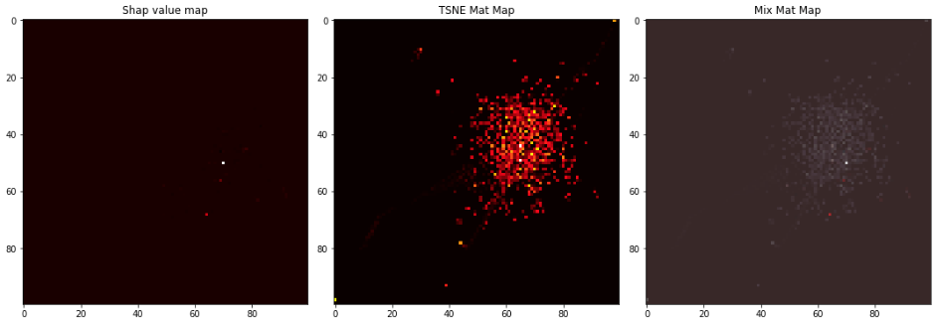
Compare - Delta

Slide 17
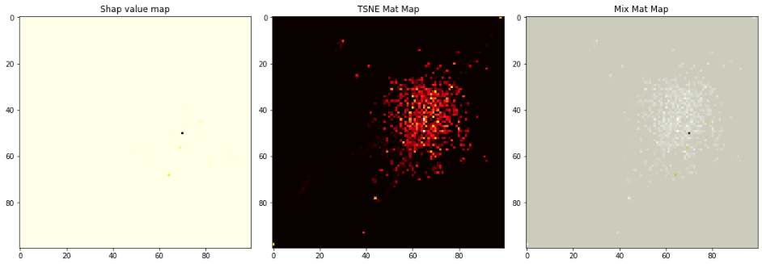
Compare - Gamma

Slide 18
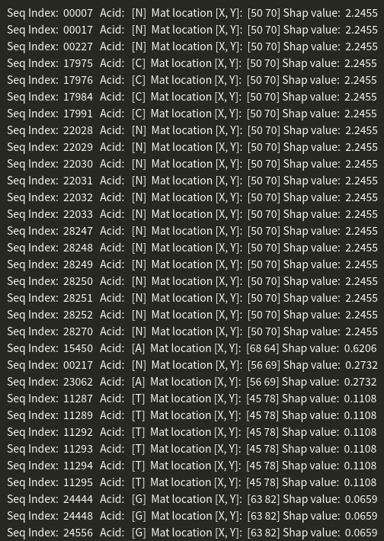
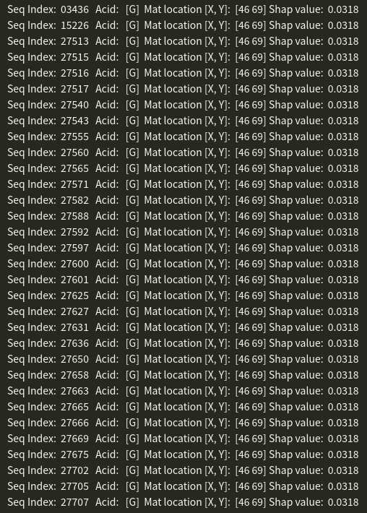

Slide 19
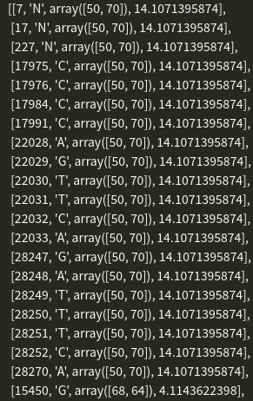
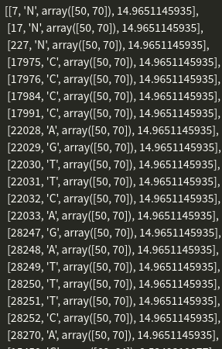
Delta - 10
Delta - 12

Slide 20
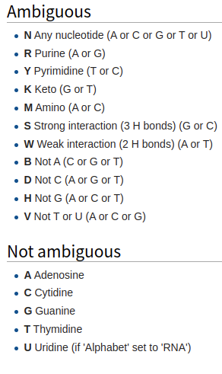
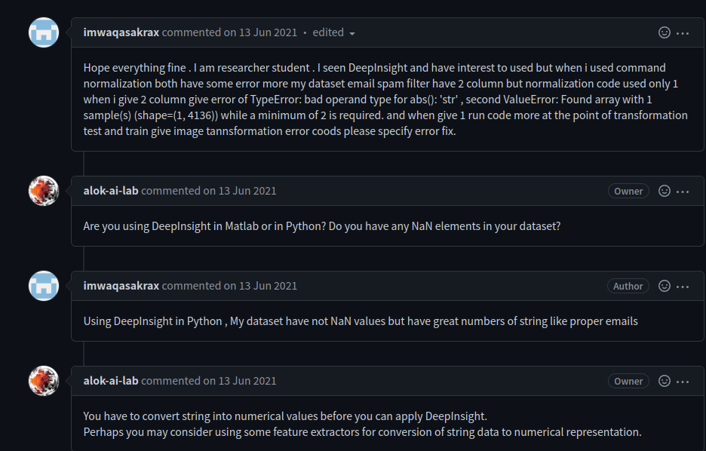

Slide 21
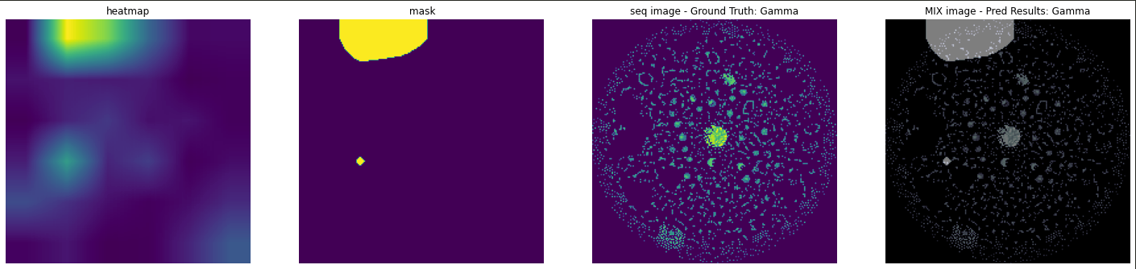
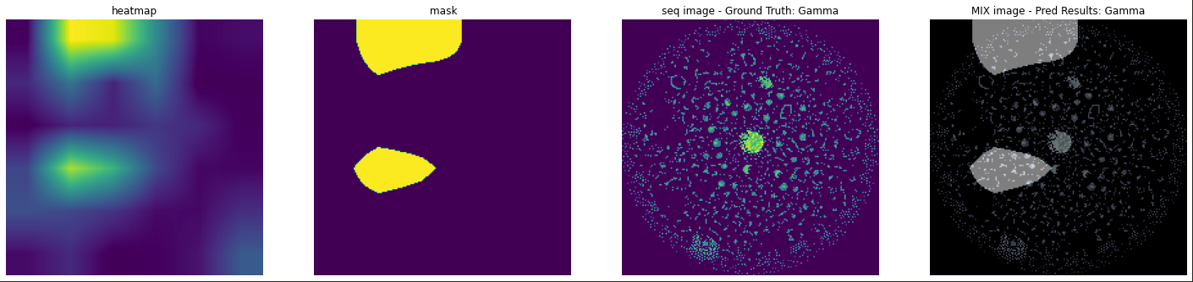
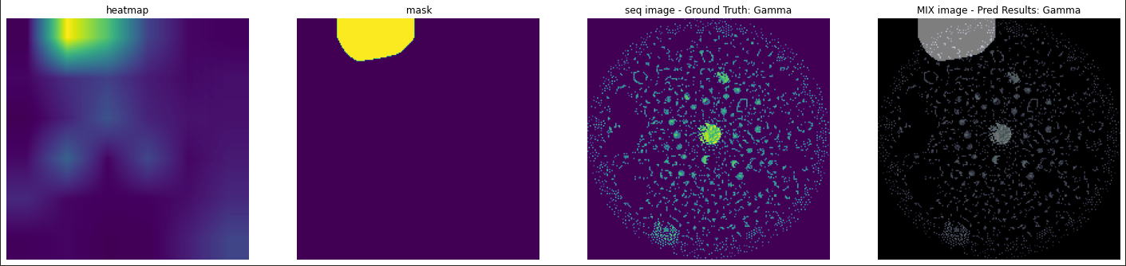

Slide 22
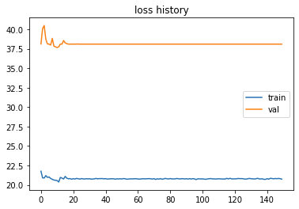
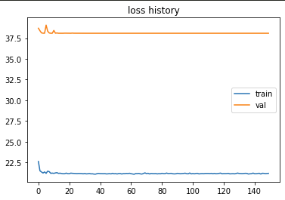
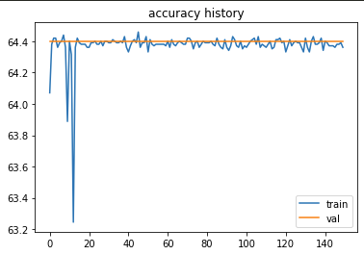
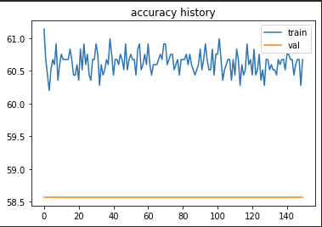
Index INTEGER[pixel 200] & index VOSS[pixel 200]

Slide 23
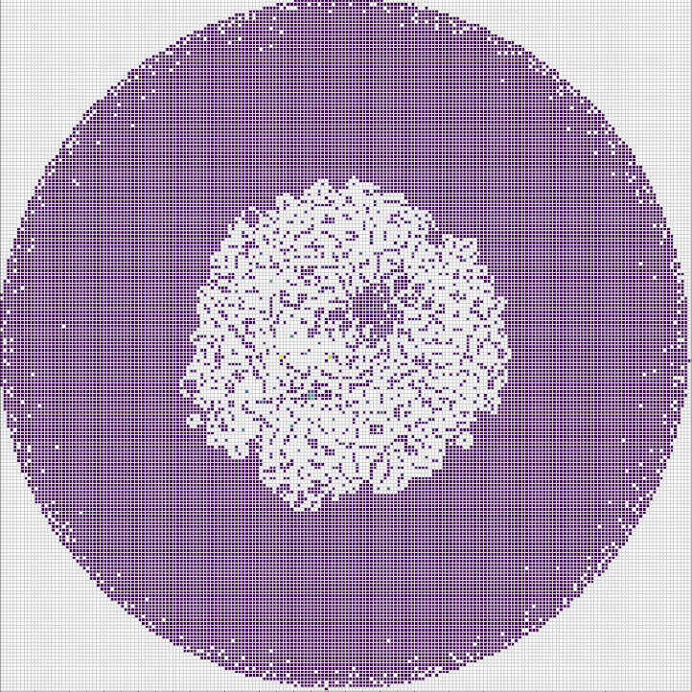
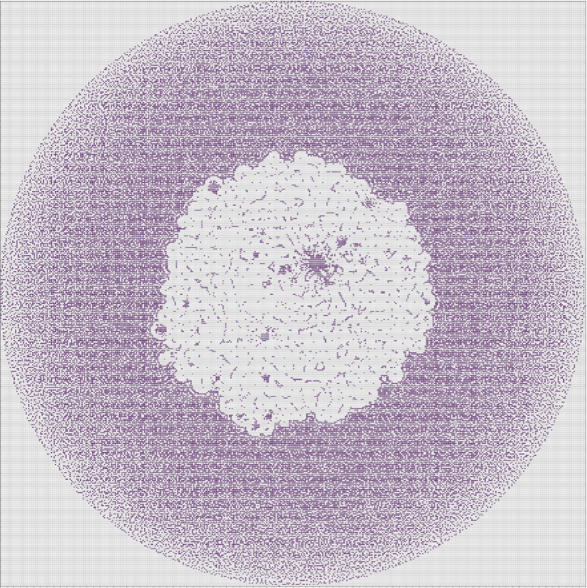
TSNE

Slide 24
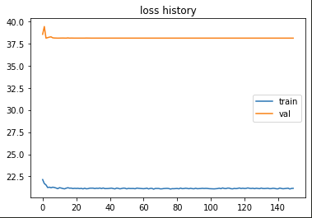
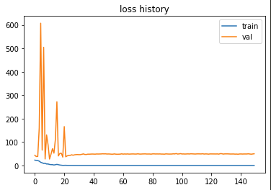
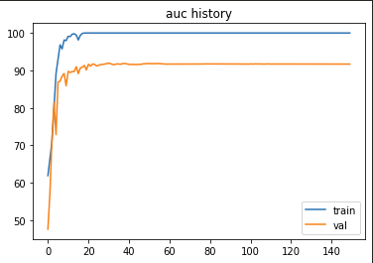
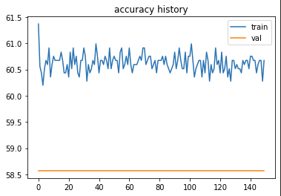
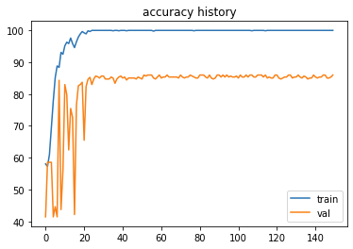
index VOSS[pixel 440] - AlexNet vs ResNet18
AlexNet
ResNet18

Slide 25
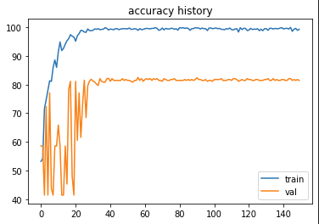
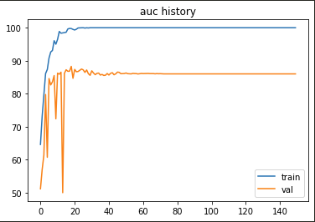
index VOSS - ResNet18[pixel 440 vs 200]
Piexel 200
Piexel 440

Slide 26

Index INTEGER vs index VOSS [pixel 200] - ResNet18
INTEGER
VOSS

Slide 27
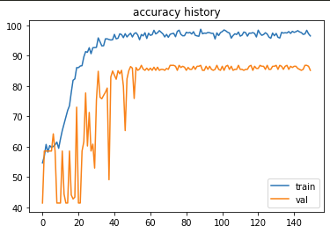
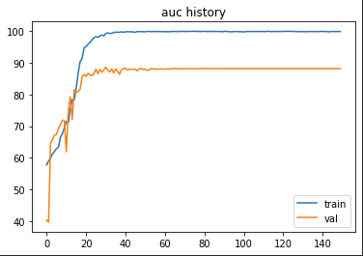
Index INTEGER vs index VOSS [pixel 400] - ResNet18
INTEGER
VOSS

Slide 28

Multiclass - Index 7, 12, 217

Slide 29





Save PCA model Object

Slide 30


Slide 31


Slide 32



Slide 33


Slide 34

DeepFeature

Slide 35





TSNE Parameter 400 x 400 [gen len 29903]
perplexity | wieght pixel sum [repeat] | AUC
5 | 10939 [4282] | 0.824
10 | 9503 [-] | -
20 | 8048 [-] | -
30 | 7452 [-] | -
50 | 6777 [3399] | 0.860

Slide 36




TSNE Parameter 400 x 400 [gen len 179418]
perplexity | wieght pixel sum [repeat] | AUC
5 | 79754 [35667] | 0.901
50 | 75681 [32122] | 0.919

Slide 37

DeepFeature

Slide 38


Grad-Cam test
px 100
px 300

Slide 39


Stage 1 -2
Stage 1
Stage 2

Slide 40


Stage 1 -2
Stage 1
Stage 2

Slide 41


Stage 1 -2
Stage 1
Stage 2

Slide 42







Slide 43





matlab command

Slide 44


Debug

Slide 45


Debug

Slide 46

Phate - outcome(B.1.617.2 update different)

Slide 47

Phate - function test

Slide 48
PHATE & TSNE

Slide 49

Phate to Deepinsight transformer

Slide 50
PHATE & TSNE Deepinsight transformer

Slide 51

ConvexHull

Slide 52

Grad Cam - lineage diff update

Slide 53




GradCAM

Slide 54

Grad Cam - lineage diff update [Layer 2-4]

Slide 55








Delta (B.1.617.2-like) Gene position

Slide 56
Gene Convert
input - > *.tsv, *.csv
output -> *.tsv(vcf format)
import Bio (biopython API)
translate mRNA into the corresponding protein sequence
feature 275-G -> Get 275-277 mRNA -> GCT -> translate protein
convert command
python convert.py --input {i}.tsv --output {o}.tsv
Notes:
ORF1ab - > 16

Slide 57



Gene Convert

Slide 58


Gene Convert - VCF format

Slide 59

Translate
Translate
V 289 L
Reference
Gene Location
Alternative

Slide 60



Convert Config
https://github.com/IlikeBB/Convert-Gene

Slide 61

Convert Results [ths>0.9]
Deep Learning [ths>0.9]
Machine Learning

Slide 62

Convert Results [ths>0.9]

Slide 63
Convert Results [ths>0.5]
Deep Learning [ths>0.5]
Machine Learning

Slide 64

Convert Results [ths>0.5]

Slide 65

Phate - gene region [lineage update]

Slide 67

Phate - gene region [lineage update]

Slide 68

Phate - gene region [lineage update]

Slide 69


MLP
Notes:
diff lineage

Slide 70


KernelExplainer - error

Slide 71


KernelExplainer - error

Slide 72


Sequential model

Slide 73


Original
Sequnetial

Slide 74



Slide 75

scikit-learn dataset

Slide 76

scikit-learn dataset - breast cancer

Slide 77

scikit-learn dataset - breast cancer

Slide 78

scikit-learn dataset - breast cancer

Slide 79


KernelExplainer - error

Slide 80

shap value bar

Slide 81


Lime - cost (gene/84 min)

Slide 82




label: diff
label: non-diff
label: non-diff
label: diff

Slide 83

Gene Filter 1000 - DeepInSight 100 pixel

Slide 84







Ver 1 - Integer (train / valid)

Slide 85






Ver 2 - EIIP
Normalized
Non-Normalized

Slide 86






Ver 2 - EIIP
Normalized
Non-Normalized

Slide 87


1000 gene len - shap value ver 1(Integer )
Notes:
bruta

Slide 88

1000 gene len - shap value (Integer )
Notes:
bruta

Slide 89

1000 gene len -TSNE GradCam [ths>0.75]

Slide 90

CNN & MLP

Slide 91



Slide 92


Slide 93

6000 gene len -TSNE GradCam [ths>0.75]

Slide 94


Slide 95

onehot problem

Slide 96


[K]-ford 10 times - mlp

Slide 97


[K]-ford 10 times - cnn

Slide 98



shap

Slide 99


batch test shap value - single [k]-fold result
explainer background train data NO.1-No.750
10 train data sample [20min]
30 train data sample [45min]
765 train data sample [ ≒1200min]

Slide 100


Problem

Slide 101



Problem

Slide 102

Problem

